Slide 1
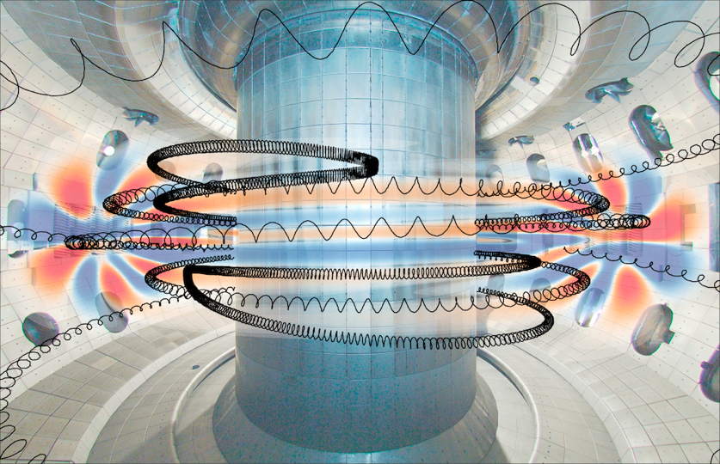


Single Particle Motion
Presented by
Cami Collins
at the
SULI Introductory Course in Plasma Physics
Princeton Plasma Physics Laboratory
June 10, 2019

Slide 2
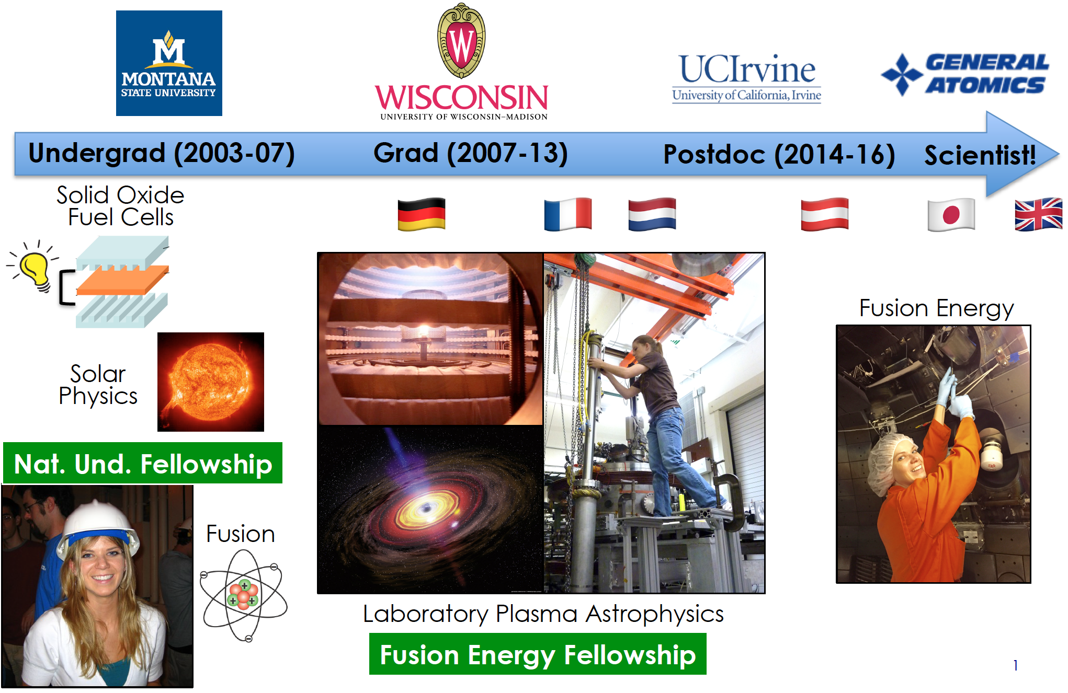
My path in plasma physics
🇫🇮

Slide 3
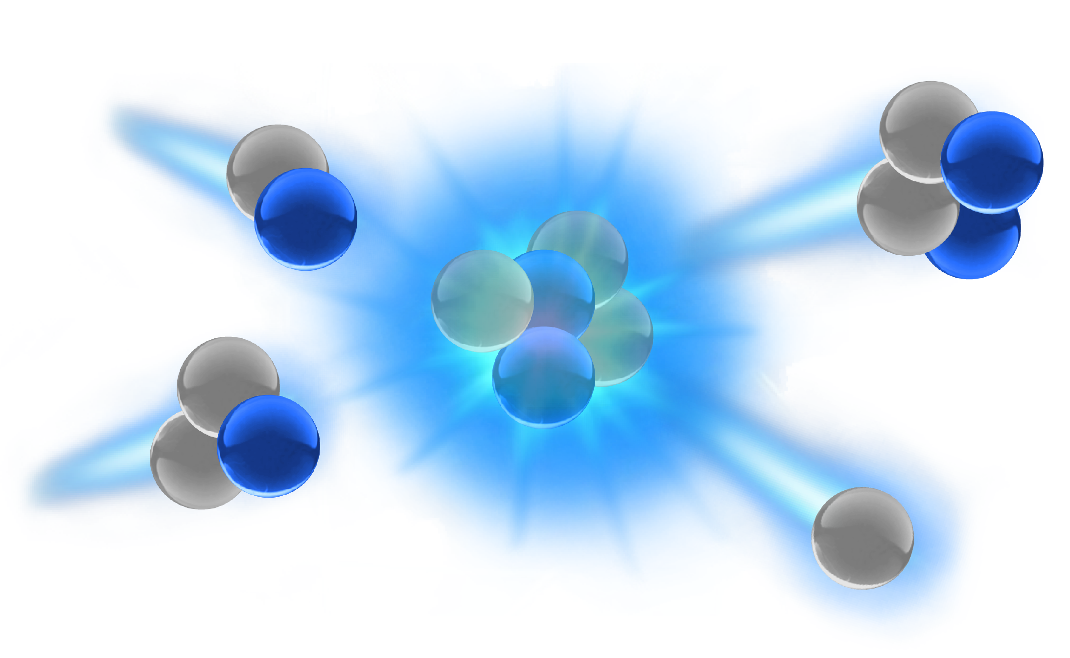
I want fusion energy to work.
But what does that mean?
plasma physics
stability
transport
turbulence

Slide 4
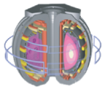
I want fusion energy to work.
But what does that mean?
plasma physics
engineering
computer science
stability
transport
turbulence
shaping
ELM controlled
high bootstrap current
high confinement
high beta
steady state
efficient current drive
dissipative divertor
disruption mitigation
control

Slide 5
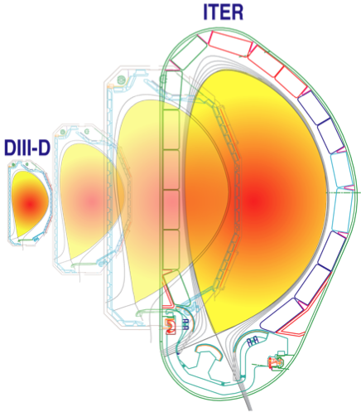
I want fusion energy to work.
But what does that mean?
plasma physics
engineering
computer science
materials science
stability
transport
turbulence
shaping
ELM controlled
high bootstrap current
high confinement
high beta
alpha heating
steady state
efficient current drive
dissipative divertor
disruption mitigation
power handling
control
tritium breeding

Slide 6
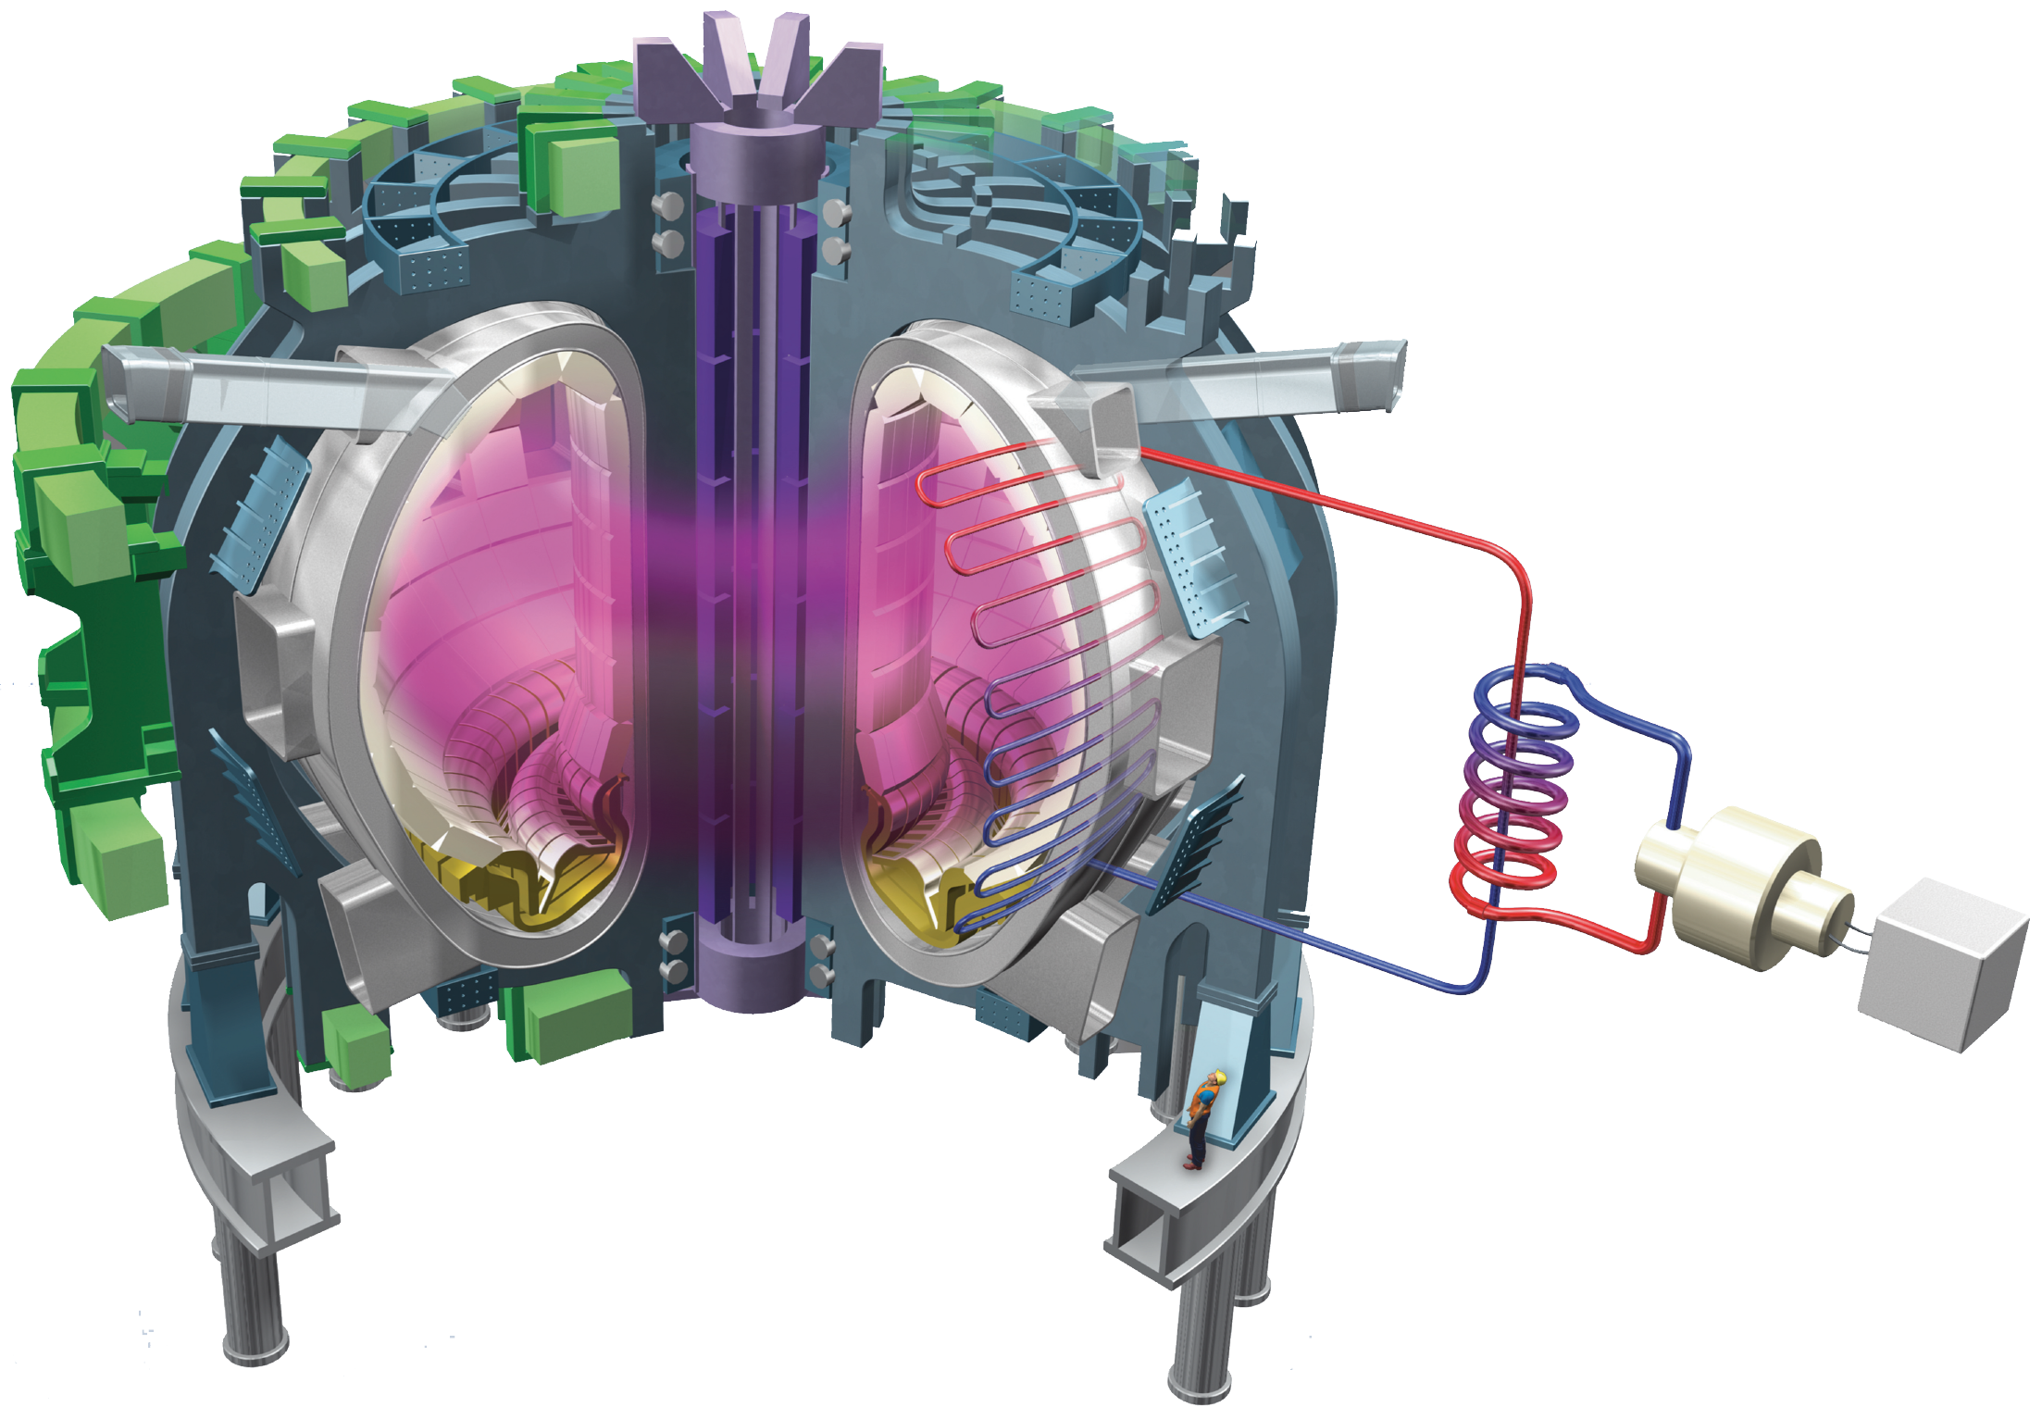

I want fusion energy to work.
But what does that mean?
plasma physics
engineering
computer science
materials science
stability
transport
turbulence
shaping
ELM controlled
high bootstrap current
high confinement
high beta
alpha heating
steady state
efficient current drive
dissipative divertor
licensing
net electricity
disruption mitigation
power handling
heat extraction
metal walls, liquid walls?
control
nuclear materials
tritium breeding

Slide 7
I want fusion energy to work.
But what does that mean?
plasma physics
engineering
computer science
social science?
materials science
political science?
$
$
stability
transport
turbulence
$
shaping
ELM controlled
high bootstrap current
high confinement
high beta
alpha heating
steady state
efficient current drive
dissipative divertor
licensing
net electricity
disruption mitigation
$
power handling
heat extraction
$
metal walls, liquid walls?
control
nuclear materials
tritium breeding

Slide 8
Plasma Physics is the Basis for Fusion Research
Deuterium
~0.01 MeV
Helium
3.5 MeV
Tritium
~0.01 MeV
Neutron
14.1 MeV
Sustained fusion reactions require enough particles (density) that are energetic enough (temperature) and collide often enough (confinement time).

Slide 9
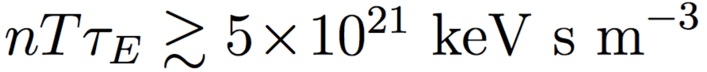
Plasma Physics is the Basis for Fusion Research
Deuterium
~0.01 MeV
Helium
3.5 MeV
Tritium
~0.01 MeV
Neutron
14.1 MeV
Sustained fusion reactions require enough particles (density) that are energetic enough (temperature) and collide often enough (confinement time).
The fusion triple product is the figure of merit:
T~100-200 million K
n~2-3x10²⁰ ions/m³
τ ~1-2 s
D & T is a plasma at these temperatures

Slide 10
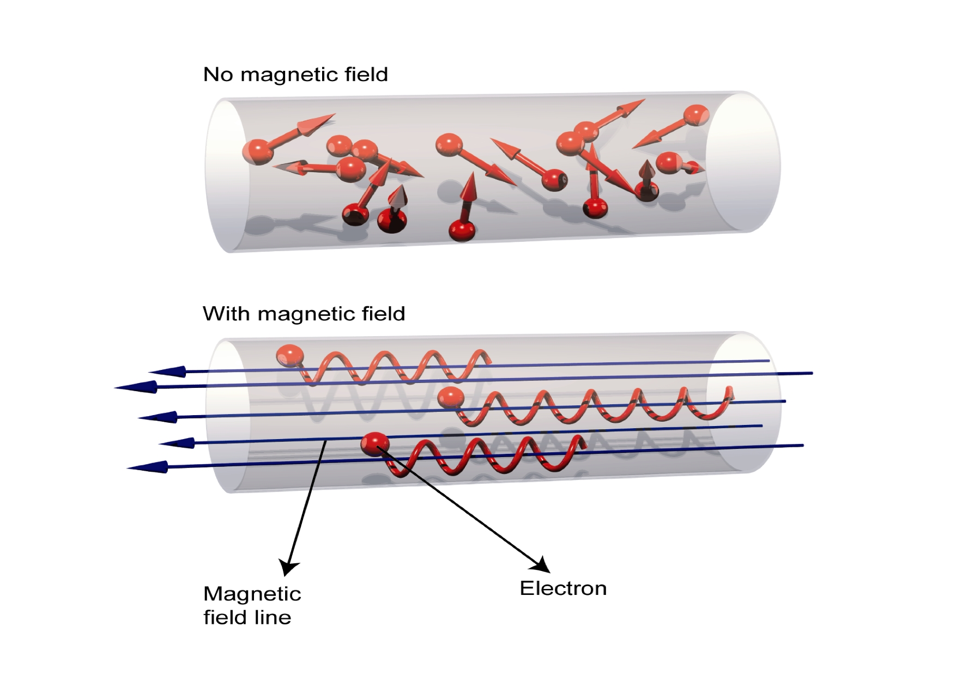
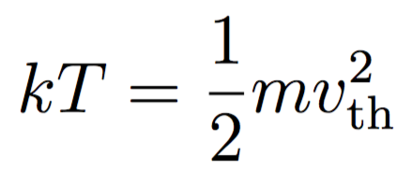
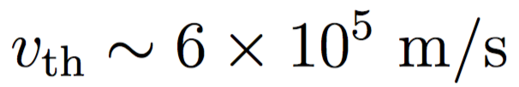
We can understand a lot about how fusion devices confine plasma by studying single particle motion.
Typical velocity of a 100 million K ion:
no magnetic field
Even with ~10²⁰ ions/m³ , the ion would travel ~10 km before colliding with another
It would be crazy to build a fusion reactor that big!
with magnetic field
The trick: use magnetic fields
magnetic field line
charged particle

Slide 11
Outline
Gyromotion about a guiding center
Forces can cause guiding center drift
Real life consequences:
Why do tokamaks have helical B fields?
What is a banana orbit?
Why are instabilities like Alfvén Eigenmodes bad for fusion?
References
NRL Plasma Formulary
www.nrl.navy.mil/ppd/content/nrl-plasma-formulary
Introduction to Plasma Physics and Controlled Fusion by F. Chen

Slide 12
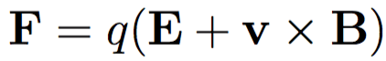

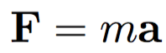
Charged Particles Feel The (Lorentz) Force
A particle with charge (q) moving with velocity (v) in the presence of electric and magnetic fields will experience a force:
We know from Newton’s second law of motion that force causes acceleration:
A charged particle
moving perpendicular to
the magnetic field feels a force

Slide 13
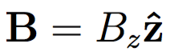
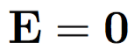
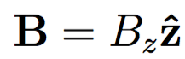
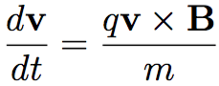
How Does a Charged Particle Move in a Magnetic Field?
Consider the motion of a particle in a constant, uniform B field
y
Then
+
So we can write
x

Slide 14
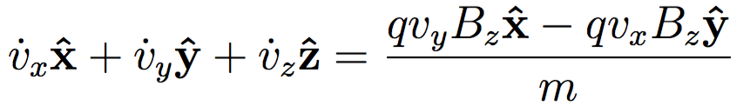
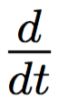
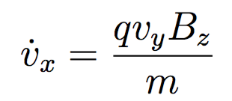
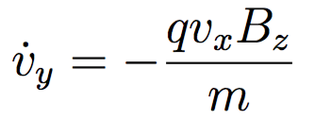
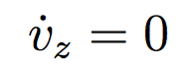
Goal: Solve the Equations of Motion for a Charged Particle In A Magnetic Field
Let’s break this into components:
y
+
The ‘dot’ represents
Matching components:
x
Particles move freely along the field line

Slide 15
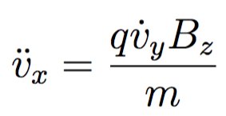
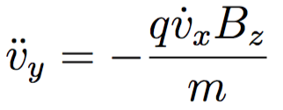
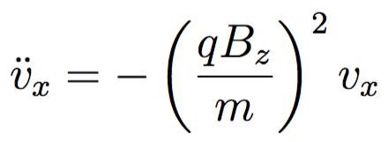
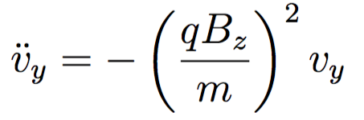
Take Another Time Derivative & Substitute to Obtain Differential Equations For Each Spatial Coordinate
Rewriting, we get
These may remind you of the equations for a simple harmonic oscillator

Slide 16
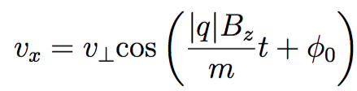
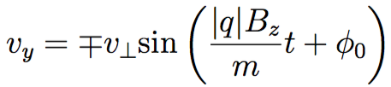
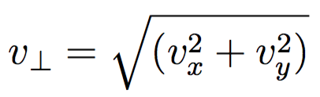
Solve the Differential Equations
These differential equations can be solved using sines and cosines:
account for positive or negative q
an arbitrary phase to match the initial velocity conditions
the magnitude of the initial velocity perpendicular to B

Slide 17
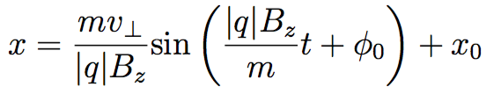
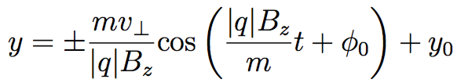
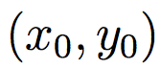
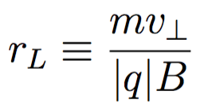
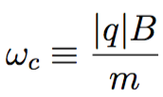
The Result: Circular Motion About A Guiding Center
Integrating, we obtain
Charged particles undergo circular orbits about a guiding center
Larmor radius
Cyclotron frequency

Slide 18
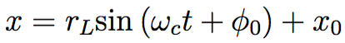
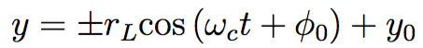
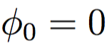
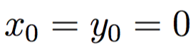
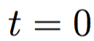
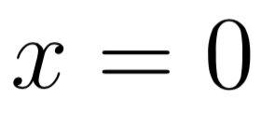
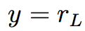
Gyromotion of a Charged Particle In A Magnetic Field
Let’s take and
y
For a positively charged particle:
1. At ,
+
x

Slide 19
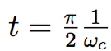
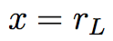
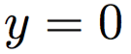
Gyromotion of a Charged Particle In A Magnetic Field
Let’s take and
y
For a positively charged particle:
1. At ,
+
x
2. At ,

Slide 20
Gyromotion of a Charged Particle In A Magnetic Field
Let’s take and
y
For a positively charged particle:
1. At ,
+
x
2. At ,

Slide 21
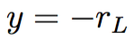
Gyromotion of a Charged Particle In A Magnetic Field
Let’s take and
y
For a negatively charged particle:
1. At ,
x
-

Slide 22
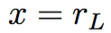
Gyromotion of a Charged Particle In A Magnetic Field
Let’s take and
y
For a negatively charged particle:
1. At ,
x
-
2. At ,

Slide 23
Gyromotion of a Charged Particle In A Magnetic Field
Let’s take and
y
For a negatively charged particle:
1. At ,
x
-
2. At ,

Slide 24
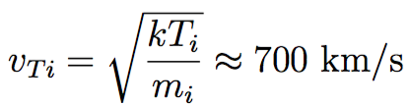
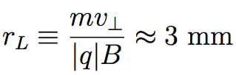
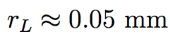
Gyromotion of Ions vs. Electrons
The direction of gyromotion depends on the sign of the charge
Ions generally have a much larger Larmor radius than electrons
In ITER, a typical deuterium ion
with T_{i}=10 keV and B=5 Tesla would have
y
+
x
-
An electron with T_{e}=10 keV and B=5 Tesla has
(60 times smaller)

Slide 25
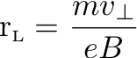
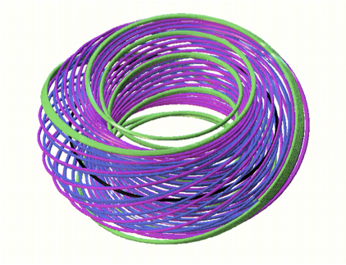

Magnetic Confinement Devices Should Be Much Larger Than the Larmor Radius
Particles are confined perpendicular to the applied magnetic field
Tokamak approach: parallel confinement is achieved through toroidal geometry
Single Magnetic Field Line
Image credit: http://iter.rma.ac.be/en/img/MagneticConfinement.jpg

Slide 26








Magnetic Mirrors
The B_{r} ends up causing additional acceleration in the z direction:
Result:
gyromotion + mirror force in the direction
The magnetic moment is
mirror force

Slide 27







Magnetic Moment Is Conserved
The magnetic moment is a constant of motion
s is the coordinate along the field line
We can write
this is
Then
We also have conservation of energy:
this is

Slide 28







More Insight Into Magnetic Mirrors
1. As the particle moves to stronger B, must increase.
2. Since energy is conserved, must decrease.
3. If B is strong enough, and the particle is reflected.
The particle is reflected when

Slide 29



Magnetic Mirror Confinement In Action
Early Fusion Experiments
Ex: Tandem Mirror Experiment (LLNL,1980’s) and other variants (Polywell devices)
Multicusp Confinement Devices
Particles with enough v|| can still escape
Charged particles can be trapped by Earth’s magnetic field

Slide 30
Time-varying Electric and Magnetic Fields Can Be Used To Accelerate & Heat Particles
A high frequency electro-magnetic field can be used to accelerate electrons or ions.
y
x
-

Slide 31


Time-varying Electric and Magnetic Fields Can Be Used To Accelerate & Heat Particles
A high frequency electro-magnetic field can be used to accelerate electrons or ions.
Particle gains energy as the applied electric field component oscillates at the cyclotron frequency (“in-phase” with the gyro-orbit).
Cyclotron frequency
y
x
-
The fluctuating accelerates the electron in the +x direction
Notes:
The transverse electric field oscillates at the cyclotron frequency. The particle velocity changes direction every half period, but so does the applied electric field. SO they remain in phase with each other. Energy is transferred to the charged particle, and the orbit will spiral outward with larger and larger rL.

Slide 32
Time-varying Electric and Magnetic Fields Can Be Used To Accelerate & Heat Particles
A high frequency electro-magnetic field can be used to accelerate electrons or ions.
Particle gains energy as the applied electric field component oscillates at the cyclotron frequency (“in-phase” with the gyro-orbit).
Cyclotron frequency
y
x
-
Now accelerates the electron in the -x direction

Slide 33
Time-varying Electric and Magnetic Fields Can Be Used To Accelerate & Heat Particles
A high frequency electro-magnetic field can be used to accelerate electrons or ions.
Particle gains energy as the applied electric field component oscillates at the cyclotron frequency (“in-phase” with the gyro-orbit).
Cyclotron frequency
y
x
-

Slide 34


The Cyclotron Frequency is Important for
Cyclotron Resonance Heating
A high frequency electro-magnetic field can be used to accelerate electrons or ions.
Particle gains energy as the applied electric field component oscillates at the cyclotron frequency (“in-phase” with the gyro-orbit).
Cyclotron frequency
y
Ex: For an electron, what B corresponds to 2.45 Ghz (microwave oven frequency)?
x
-

Slide 35


Example of Cyclotron Heating in Action
Electron Cyclotron Heating In A Plasma Experiment at UW-Madison
(2.45 GHz, B=875 Gauss)
In the DIII-D tokamak, use 110 GHz second harmonic heating (B~2 Tesla)

Slide 36





Other Practical Applications: EM Emission from Charged Particle Acceleration
Electron cyclotron emission (measure T_{e} profiles) Produced by acceleration of gyrating charged particle EM radiation emitted at discrete frequencies:
B
-
Detected radiated power is proportional to T_{e}:
Bremsstrahlung emission Produced by deceleration of deflected charged particle
+
Radiated power depends on n_{e}, Te, charge state Z_{eff}
(can be used to measure Z_{eff})
-

Slide 37


Next Simplest Case to Analyze: Constant, Uniform Electric Field Perpendicular to Magnetic Field
y
+
x

Slide 38
Next Simplest Case to Analyze: Constant, Uniform Electric Field Perpendicular to Magnetic Field
y
Accelerates due to E
+
Faster velocity increases vxB
x

Slide 39
Next Simplest Case to Analyze: Constant, Uniform Electric Field Perpendicular to Magnetic Field
y
Accelerates due to E
+
Faster velocity increases vxB
x
Decelerates

Slide 40
Next Simplest Case to Analyze: Constant, Uniform Electric Field Perpendicular to Magnetic Field
y
Accelerates due to E
+
Faster velocity increases vxB
x
Decelerates

Slide 41



Next Simplest Case to Analyze: Constant, Uniform Electric Field Perpendicular to Magnetic Field
y
+
x
Ion guiding center drifts in the direction

Slide 42

Guiding Center Drift Due to E x B
Electron guiding center also drifts in the direction
y
The ExB drift can be written more generally as
x
-
ExB drift is independent of charge and mass
Both electrons and ions move together

Slide 43



Other Forces Can Cause Guiding Center Drift
Any force perpendicular to B can cause particles to drift
Drift due to force:
Examples of forces:
gravity
centrifugal
R_{c}
Bend the magnetic field into a donut shape
No end losses because the field lines go around and close on themselves
BUT a particle following a toroidal magnetic field would experience F_{cf}

Slide 44


Curvature Drift Due to Bending Field Lines
The outward centrifugal force causes curvature drift
R_{c}
z
A particle moving along a curved field line will drift up or down, depending on the sign of the charge
B_{toroidal}

Slide 45





Spatially Varying Magnetic Field Strength Also Causes Drift

Slide 46
Spatially Varying Magnetic Field Strength Also Causes Drift
+
The gyro-radius will be larger where the field is weaker and smaller where the field is stronger

Slide 47

Spatially Varying Magnetic Field Strength Also Causes Drift
+
-
The gyro-radius will be larger where the field is weaker and smaller where the field is stronger
The resulting drift velocity is described by:

Slide 48

What Happens To Charged Particles In A Purely Toroidal Magnetic Field?
Charged particles in a curved magnetic field will experience both ∇B and curvature drift: these effects add
z
ɸ
B_{toroidal}
+
+
+
+
Ion
drift
Electron
drift
-
-
-
-

Slide 49
Charged Particles Will Drift Outward
Charged particles in a curved magnetic field will experience both ∇B and curvature drift
z
ɸ
B_{toroidal}
+
+
+
+
Ion
drift
E
Electron
drift
-
-
-
-
This means that no matter what, particles in a torus with a purely toroidal field will drift radially out and hit the walls.

Slide 50
Tokamak Solution: Add Poloidal Magnetic Field
Toroidal: long way around
Poloidal: short way around
1. Use external coils to apply a toroidal magnetic field
2. Drive toroidal current in the plasma to generate a poloidal magnetic field
z
ɸ
B_{toroidal}
B_{poloidal}
I_{plasma}
The resulting helical magnetic field is much better at confining charged particles.
The challenge: how to drive current in plasma in steady state while keeping the plasma stable and free of disruptions?

Slide 51

There Are Two Main Classes of Particle Orbits In Tokamaks
z
z
ɸ
B_{t}
ɸ
B_{t}
B_{p}
B_{p}
R
R
Passing
Trapped
Particles with sufficient v||will follow the helical magnetic field around the torus
Particles with lower v|| are reflected as they encounter stronger B and therefore execute “banana” orbits as they precess around the torus B

Slide 52


Banana Orbits
Particles that don’t have enough v|| are reflected by the mirror force at the high field side of the tokamak
Trapped particles won’t hit the wall if the banana orbit width Δr is small enough
Image credit: euro-fusion.org

Slide 53

Classifying Particle Orbits In Tokamaks Is Important for Understanding Basic Physics Mechanisms Like Wave-Particle Interactions
Image credit: Pace et. al.,Physics Today (2015)

Slide 54



Particle Resonance With Alfvén Eigenmode (AE) Instabilities
Occurs when the wave and particle orbit phases match after many cycles:
ω = lω_{ci} + pω_{θ} + nω_{ζ}
AE mode frequency
Time to complete toroidal orbit
Time to complete cyclotron orbit
Time to complete poloidal orbit
[W.W. Heidbrink, Phys. Plasmas 15 (2008)]
Notes:
Now, fast ions can be resonant with Alfven eigenmodes if they are in phase with the mode after an integer number of orbits. There are 3 characteristic orbit frequencies, this is the ion gyromotion, then there is the time that it takes a fast ion to precess around the tokamak and complete a toroidal orbit, and then there is the time that it takes to complete a poloidal orbit. Resonance can occur if the phase of the particle and the wave match after many cycles. A nice picture to have in your head is that as the particle executes it’s orbit, it stays in phase with the same node of the mode. Power transfer can occur between the particle and the transverse component of the electric field, and in this case the energy received from the mode cause the particle to cross a topology boundary and become lost.

Slide 55
Particle Resonance With Alfvén Eigenmode (AE) Instabilities
Occurs when the wave and particle orbit phases match after many cycles:
ω = lω_{ci} + pω_{θ} + nω_{ζ}
AE mode frequency
Time to complete toroidal orbit
Time to complete cyclotron orbit
Time to complete poloidal orbit
Power transfer can occur as the ion stays in phase with the wave as it traverses the mode
[W.W. Heidbrink, Phys. Plasmas 15 (2008)]
[Pace, Physics Today (Oct. 2015)]
Notes:
Now, fast ions can be resonant with Alfven eigenmodes if they are in phase with the mode after an integer number of orbits. There are 3 characteristic orbit frequencies, this is the ion gyromotion, then there is the time that it takes a fast ion to precess around the tokamak and complete a toroidal orbit, and then there is the time that it takes to complete a poloidal orbit. Resonance can occur if the phase of the particle and the wave match after many cycles. A nice picture to have in your head is that as the particle executes it’s orbit, it stays in phase with the same node of the mode. Power transfer can occur between the particle and the transverse component of the electric field, and in this case the energy received from the mode cause the particle to cross a topology boundary and become lost.

Slide 56

The Fast Ion Distribution Function Is “Most Simply” Described Using Constants of Motion
Projection of 80 keV D⁺ orbit in the DIII-D tokamak
[R. B. White, Theory of toroidally confined plasmas, Imperial College Press (2001)]
Notes:
As an introduction, fast ions are most simply described using constants of motion in what’s called orbit topology space. So this is a plot of magnetic moment, normalized by particle energy, vs the toroidal canonical angular momentum. In this space, you can classify particle orbits as, say trapped, so these are banana orbits, co-passing, so they are traveling in the same direction as plasma current, counter passing. Some special orbits exist with names like potato or stagnation.
So for example, this is the projection of a full energy fast ion orbit for a counter passing particle. If the particle had slightly higher perpendicular velocity, it would be located on the other side of the topological boundary and the particle would be lost.
Magnetic moment = mv_perp^2/(2B)

Slide 57

Small Changes in Particle Energy Can Cause Large Changes in Orbit Topology
Projection of 80 keV D⁺ orbit in the DIII-D tokamak
[R. B. White, Theory of toroidally confined plasmas, Imperial College Press (2001)]
Notes:
As an introduction, fast ions are most simply described using constants of motion in what’s called orbit topology space. So this is a plot of magnetic moment, normalized by particle energy, vs the toroidal canonical angular momentum. In this space, you can classify particle orbits as, say trapped, so these are banana orbits, co-passing, so they are traveling in the same direction as plasma current, counter passing. Some special orbits exist with names like potato or stagnation.
So for example, this is the projection of a full energy fast ion orbit for a counter passing particle. If the particle had slightly higher perpendicular velocity, it would be located on the other side of the topological boundary and the particle would be lost.
Magnetic moment = mv_perp^2/(2B)

Slide 58
There Can Be Several Different Populations of Fast Ions In Fusion Devices
neutral beam injection
Example of distribution function F(E,μ,P_{ϕ}) for neutral beam injection, which is anisotropic and non-Maxwellian
The distribution function for fusion products (alpha particles) is isotropic
[R. B. White, Theory of toroidally confined plasmas, Imperial College Press (2001)]
Notes:
This is an example of the types of fast ions created by neutral beam injection. You can see that neutral beam injection creates a distribution function that is anisotropic and non-Maxwellian.

Slide 59
Active Research: Calculating the Energetic Particle Distribution Function After Transport by Instabilities
Beam Deposition
Resonance (Many Modes)
Transport can occur if fast ions intersect AE resonances in this “phase space” plot
In certain conditions, AEs can cause significant transport of fast ions and significantly degrade fusion performance → We are working on controlling/avoiding AEs
Notes:
Because of this resonance phenomenon, AE transport is inherently a phase space dependent process. So back to orbit topology space diagram, the red squares represent all of the possible resonances that are possible for just a single Alfven eigenmode. You can see that AEs can affect certain parts of fast ion phase space, but leave other parts unaffected. So you would expect to measure tranpsort at the intersection where your diagnostic is sensitive, where fast ions are present, and where fast ions can resonate with AEs. In reality there are often multiple modes which end up basically painting much of fast ion phase space.

Slide 60

Conclusions
Charged particles undergo gyromotion about magnetic fields, and are free to move along the magnetic field line.
Depending on magnetic field geometry or the presence of other forces like electric fields, particles can drift across field lines (and even leave the system→hit the walls).
(One) challenge for fusion energy research is to confine enough charged particles that are energetic enough for long enough lengths of time to achieve sustained fusion.

